Slide 1

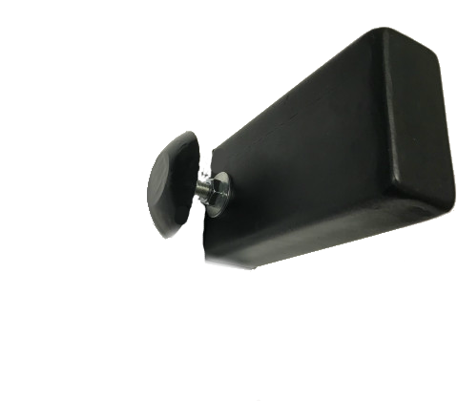
Well monitoring based on LoraWan and NB-IoT networks

Slide 2
The hatch opening sensor uses the NB-IoT network of the B1(2100), B3(1800), B5(850), B7(2600) B8(900) B200(800) MHz band or LoRaWAN RU864-868 EU863-870 KZ865-868 band for transmission messages and is designed for remote control of unauthorized access to wells. The sensor allows you to track the opening of hatches and prevent emergencies. The sensor is mounted under the hatch cover and is triggered when the cover is lifted by a signal from the accelerometer. The sensor antenna is displayed on the outer side of the hatch, which ensures reliable radio reception over a long distance.
The sensor is installed in a metal case, which is bolted to the hatch.
The sensor board is additionally protected by a sealed plastic case, which is equipped with a tamper-evident sensor.
The MHM V.1.01 sensor is designed to work with LoRaWAN networks, the MHM V.1.02 sensor - with NB-IoT networks

Slide 3
Параметры
Options | Meaning
Operating frequency ranges, MHz | NB-IoT B1(2100), B3(1800), B5(850), B7(2600) B8(900) B200(800) LoRaWAN RU864-868 EU863-870 KZ865-868
Operating temperature range, °C | - 40…+85
Overall dimensions, mm | 300х100х55
Weight, g | 500
Degree of protection | IP67
Life time | At least 10 years
Battery operation | At least 5 years

Slide 4
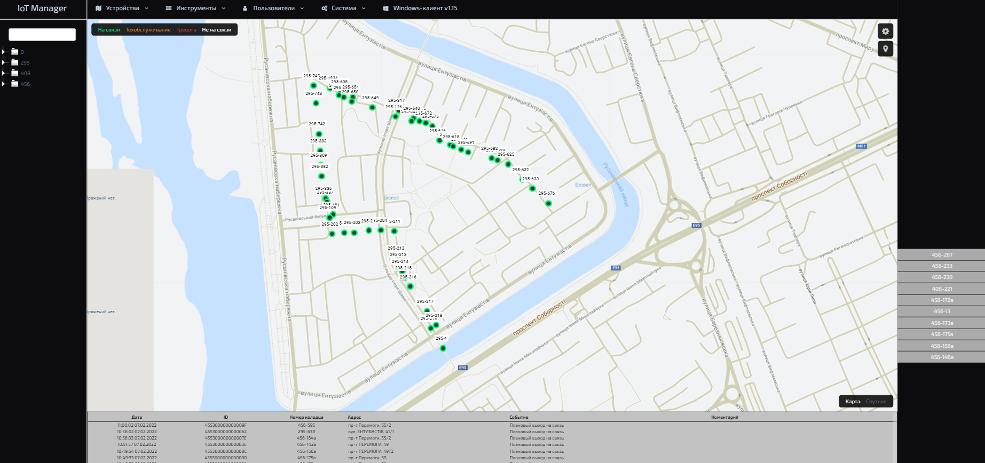
WEB interface
,

Slide 5
Software
The hatch monitoring software is designed as a virtual machine and can be deployed both at the customer’s site and used by the solution manufacturer’s virtual servers on the Internet.
Consists of three key elements, web server, database, IoT hub program. IoT-hub works with sensors via NB-IoT and LoraWAN networks.
The solution allows receiving messages from sensors, managing and configuring sensors. Exchange with sensors two-way.
A convenient interface for monitoring the state of manholes, which allows you to display the status of manholes: connected or not, authorized access, unauthorized opening, body opening, signal level, etc. On the map, you can display all hatches or in layers, depending on the events.
In addition to the web interface, there is a program installed on Windows that runs in the background. In case of unauthorized opening of wells, the program duplicates the web interface alarm. The solution excludes the possibility of skipping alarm messages

Slide 6
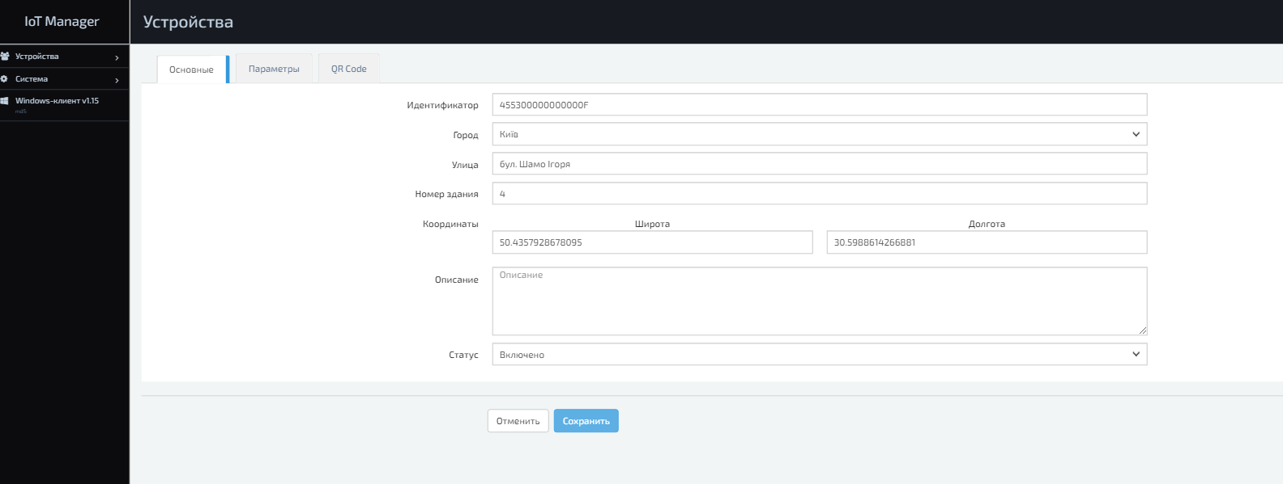
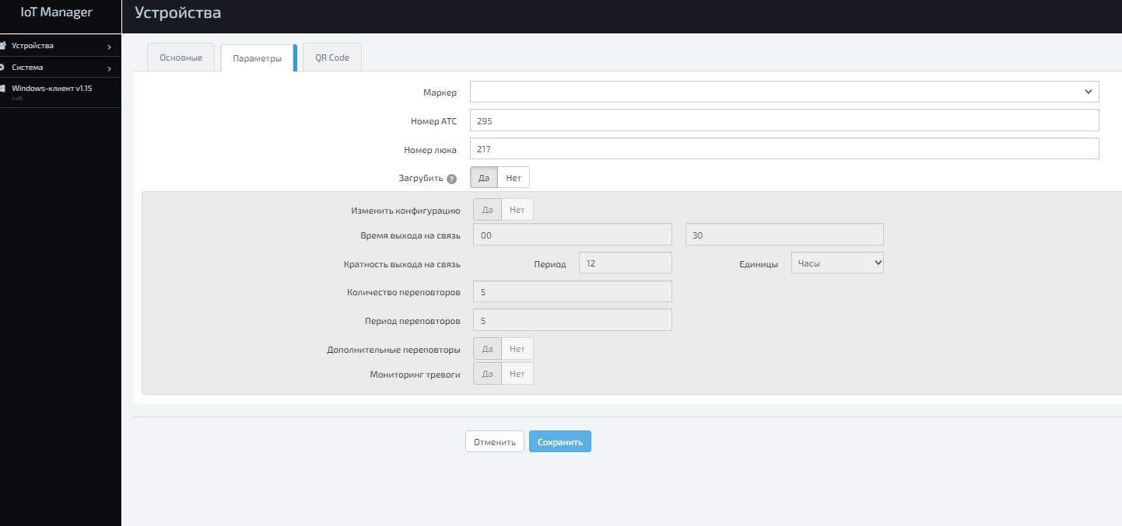
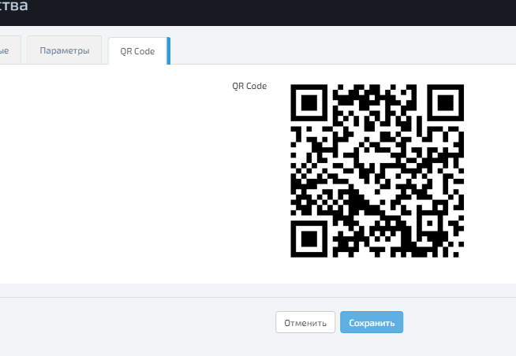
Sensor configuration
Each sensor can be individually configured

Slide 7
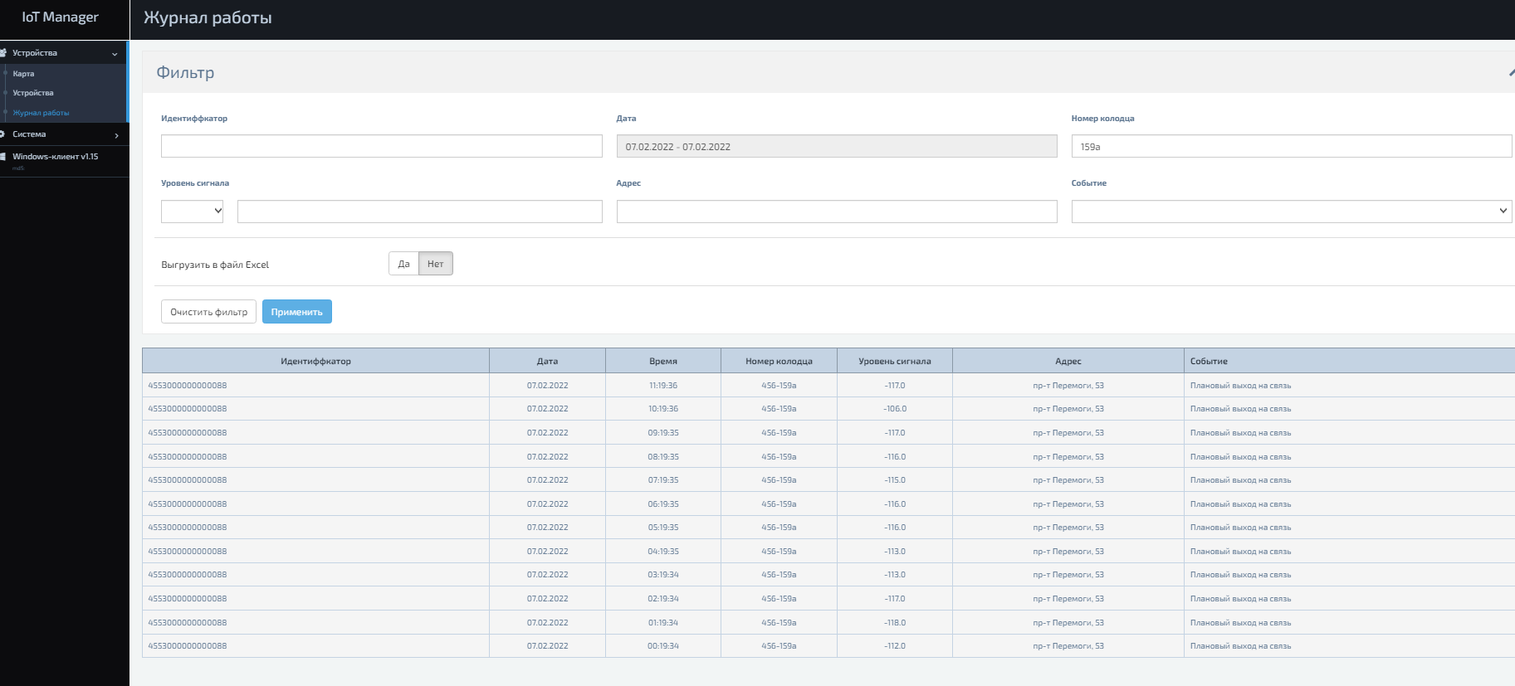
Event logging
With the help of a convenient filter, it is possible to obtain information from the logs of the required content. Monitor the performance of a particular sensor. Display alarm events for all sensors, low batteries, etc.

Slide 8
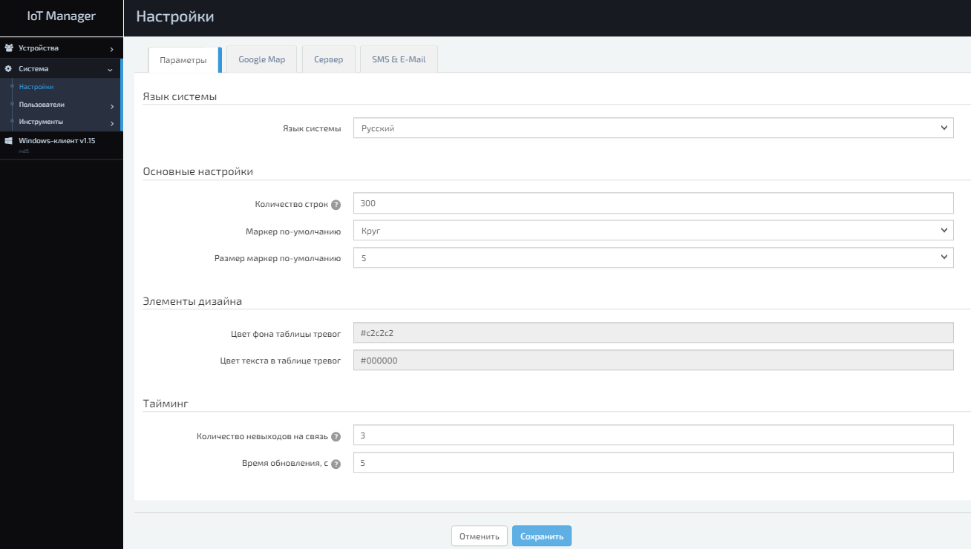
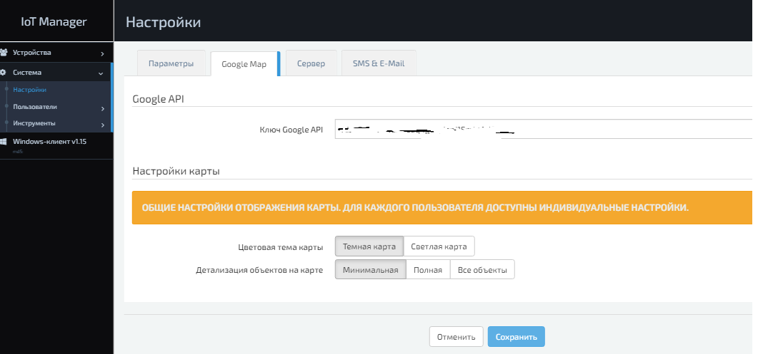
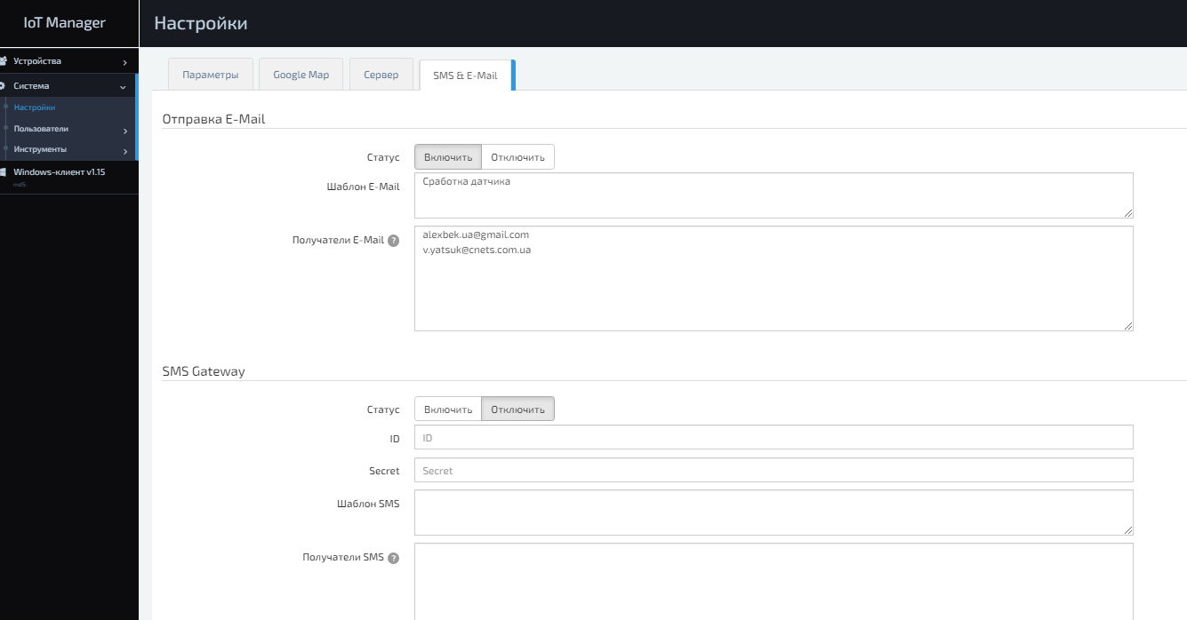
Individual web interface settings, sending email and SMS
The web interface can be configured individually. Light or dark backgrounds, detailing of map objects, set up sending messages to email and/or sending SMS messages.

Slide 9
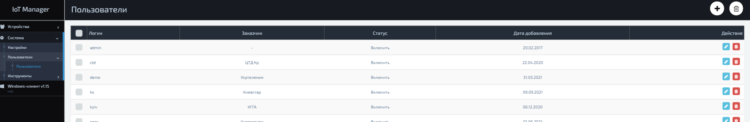
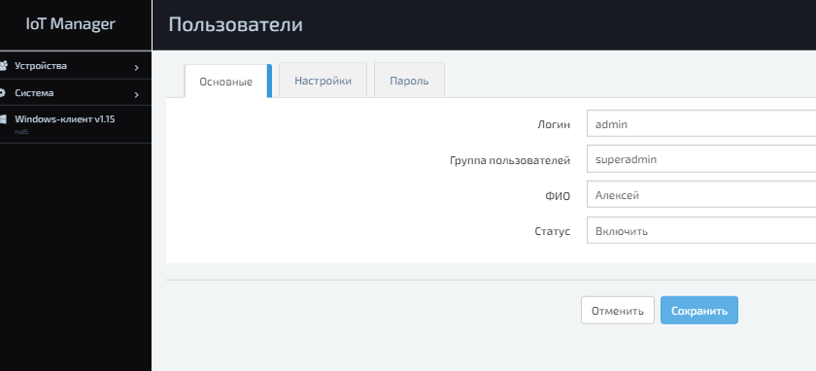
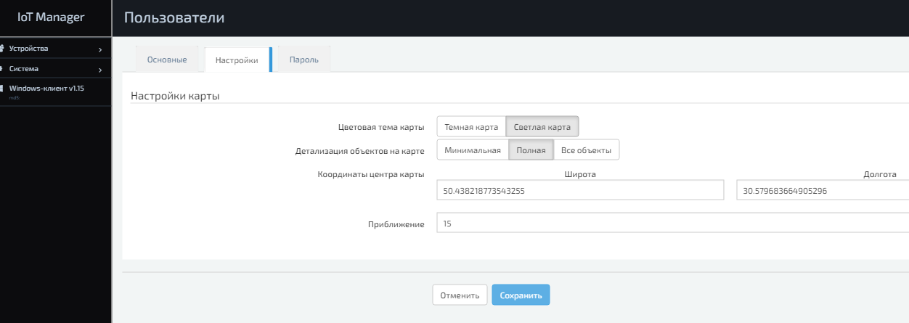
User management
It is possible to create users with different access rights, with the binding of sensors to the user and individual parameters of the graphical interface
Tel. +38(067) 550 20 81
v.yatsuk@cnets.com.ua

